Slide 1
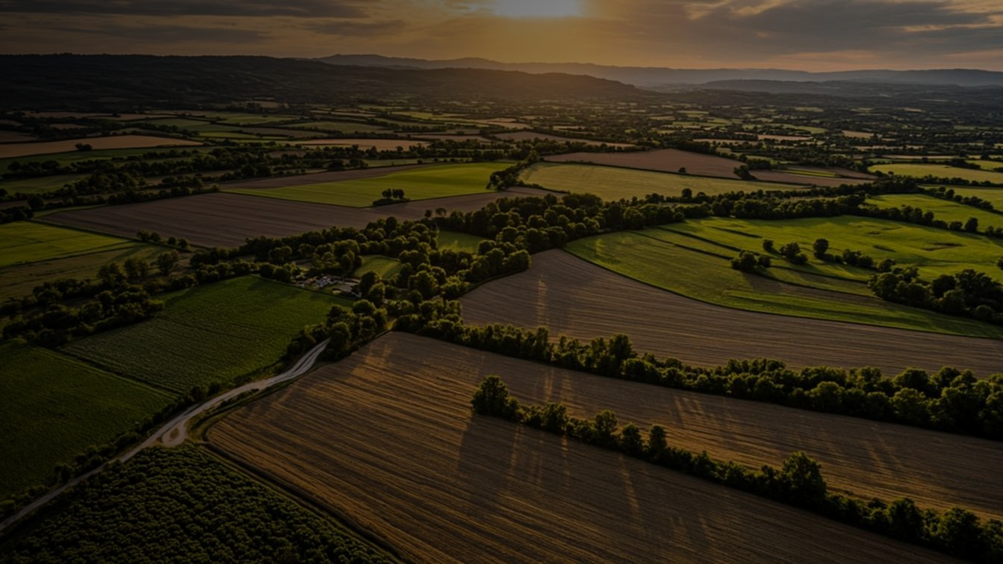

FARMVERSE
Intelligent Farm Operations Platform with Smart Agro Precision System
INTERNSHIP PROGRAM
PROJECT GUIDE
TEAM B
Infosys Springboard Internship
Ragul S
July 2026

Slide 2






Problem Statement
Why traditional farming needs a digital upgrade
No Weather Awareness
Farmers lack timely, localized forecasts for planning
AN INDUSTRY SNAPSHOT
~40%
Poor Irrigation Planning
Water is applied on guesswork, not soil or crop need
of potential yield can be lost to untimely irrigation, weather surprises, and late disease detection
Crop Disease Losses
Late detection of disease leads to avoidable crop damage
Manual Record Keeping
ROOT CAUSE
Paper-based logs are error-prone and hard to analyze
Farm data on weather, soil, crops, and irrigation stays scattered and disconnected — with no single platform turning it into a timely decision.
Low Productivity
Disconnected data means missed yield opportunities
FarmVerse | Infosys Springboard Internship
2

Slide 3







Proposed Solution
FarmVerse now spans 22 modules across six connected pillars
Farm
Operations
Support &
Governance
Weather &
Satellite Intel
FarmVerse
Platform
Trust &
Traceability
AI Advisory
& Crop Care
Market &
Finance
FarmVerse | Infosys Springboard Internship
3

Slide 4





















System Architecture
Farmer / User
React 19 + TS + Vite
REST API (JSON)
Spring Boot Backend — 22 Modules
Authentication
Farmer Mgmt
Farm Mgmt
Crop Mgmt
Soil Analysis
Irrigation + IoT
Weather
Satellite NDVI
Disease Detection
AI Advisory
Crop Simulator
Voice Assistant
Mandi Prices
Credit Scoring
Carbon Footprint
Equipment Rental
Crop Rescue
Traceability
Notifications
Reports
Admin Governance
Settings
MySQL Database
Google Gemini AI
Open-Meteo API
Persistent relational data (26 entities)
Text advisory + image-based disease vision
Live weather + geocoding, no key required
FarmVerse | Infosys Springboard Internship
4

Slide 5















Technology Stack
A modern, production-grade full stack
FRONTEND
BACKEND
SECURITY
DATABASE
React 19 + TypeScript + Vite
Spring Boot · Java 21
Spring Security + JWT
MySQL
ORM
AI & VISION
LIVE DATA
DOCS & UI
Hibernate (Spring Data JPA)
Open-Meteo (Weather + Geocoding)
OpenPDF · ZXing QR · Recharts · Framer Motion
Google Gemini
FarmVerse | Infosys Springboard Internship
5

Slide 6




User Roles & Permissions
Four roles, each scoped to exactly what they need
Farmer
Agronomist
Admin
Normal User
Full operational access
Elevated advisory powers
Full platform governance
Public / consumer access
Farms, Crops, Soil, Irrigation (+ IoT)
Everything a Farmer sees, across all farms
Everything an Agronomist has
Weather, Satellite, Mandi, Traceability
Disease scan, AI Advisory, Simulator
Prescribe disease treatment
View / edit any user
Credit info, Simulator, Carbon Tracker
Mandi, Credit, Carbon, Equipment
Endorse credit scores
Change roles, suspend accounts
Equipment Rental, Voice Bot
Voice Bot, Crop Rescue, Reports
Certify / recall produce batches
Platform-wide statistics
AI Advisory, Crop Rescue
FarmVerse | Infosys Springboard Internship
6

Slide 7
Module Architecture I
Core farm operations & on-field intelligence
Authentication
Farmer Management
Farm Management
Crop Management
Secure JWT login & role-based access
Manage farmer profiles
Track farm & land records
Manage crop cycles & varieties
Soil Analysis
Irrigation + IoT
Weather
Satellite NDVI
Assess soil health parameters
Schedules + real device telemetry
Live forecasts via Open-Meteo
Vegetation health per farm
Disease Detection
AI Advisory
Crop Simulator
Gemini Vision-based crop scan
Gemini-powered chat & tips
What-if yield calculator
FarmVerse | Infosys Springboard Internship
7

Slide 8
Module Architecture II
Marketplace, sustainability, support & governance
Voice Assistant
Mandi Prices
Credit Scoring
Carbon Footprint
Multi-lingual Kisan Vani Q&A
e-NAM prices + arbitrage calculator
Alternative agri-credit & micro-loans
Farm audits + green credit market
Equipment Rental
Crop Rescue (SOS)
Traceability
Notifications
P2P machinery marketplace
Emergency agronomic protocols
QR-coded farm-to-fork tracking
Real-time farmer alerts
Reports
Admin Governance
Settings
Exports PDF farm reports
User management & platform stats
User preferences
FarmVerse | Infosys Springboard Internship
8

Slide 9




Database Design
26 entities grouped into five functional domains
Identity
Farm Core
Health & AI
Market & Finance
Trust & Support
User
Farm
DiseaseDetection
MandiPrice
ProduceBatch
Farmer
Crop
DiseaseTreatmentLog
CreditScore
ProduceReview
UserSettings
SoilData
CropRecommendation
LoanApplication
CropRescue
IrrigationSchedule
CropSimulation
CarbonFootprint
VoiceConsultation
IoTDevice
SatelliteNdvi
CarbonCreditListing
Notification
Equipment
Report
EquipmentBooking
FarmVerse | Infosys Springboard Internship
9

Slide 10



Project Workflow
Core journey, plus on-demand tools available anytime from the dashboard
1
2
3
4
5
6
7
8
9
10
11
Register
Login
Add Farm
Soil Data
Weather
Crop Rec.
Irrigation
Disease Scan
Notify
Dashboard
Reports
ON-DEMAND, FROM ANY ROLE'S DASHBOARD
Mandi
Prices
Credit Scoring
Carbon Tracker
Equipment Rental
Crop Rescue
Crop Simulator
Traceability
Voice Assistant
AI Advisory
FarmVerse | Infosys Springboard Internship
10

Slide 11












Key Features
Headline capabilities across the full platform
Secure Login (JWT)
Weather Forecast
Satellite NDVI
Soil Health Analysis
AI Disease Detection
Gemini AI Advisory
Smart Irrigation + IoT
e-NAM Mandi Prices
Agri-Credit Scoring
Carbon Credit Market
Equipment Rental
QR Traceability
SOS Crop Rescue
Voice Assistant
Real-time Alerts
PDF Reports
FarmVerse | Infosys Springboard Internship
11

Slide 12

Dashboard UI Mockup
FarmVerse — Farmer Dashboard
THOMAS SHELBY
Weather
Soil Health
Farm Details
32°C · Partly Cloudy
Moisture: 62% · Good
4.2 acres · Zone B
AI Crop Advisory
Irrigation Schedule
Notifications
Gemini suggests: Maize, Ragi
Next cycle: Tomorrow 6 AM (IoT)
3 new alerts pending
Yield Statistics — Interactive Chart
FarmVerse | Infosys Springboard Internship
12

Slide 13
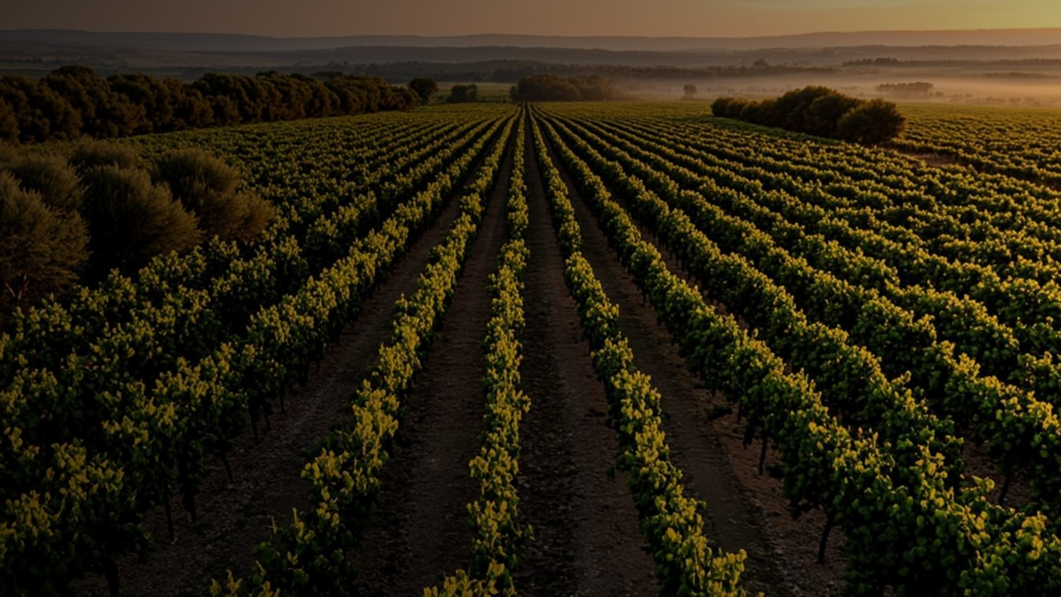








Future Enhancements
Several earlier roadmap items — IoT, voice assistant, AI advisory — are now live. Here's what's next.
Real Satellite
Imagery (Sentinel)
Drone Field
Monitoring
Blockchain-backed
Traceability
Offline-First
Mobile App
Payment Gateway
Integration
Full Multi-Language
UI Localization
Predictive Yield
Forecasting
SMS / Push
Alerts
FarmVerse | Infosys Springboard Internship
13

Slide 14






Conclusion
FarmVerse has grown from a concept into a complete, role-aware farming platform
Improves Productivity
AI-backed decisions raise farm output
PROJECT AT A GLANCE
AI-Powered Throughout
22
Backend Modules
Gemini drives advisory & disease detection
26
Database Entities
Builds Trust
QR traceability from farm to consumer
2
AI / External Integrations
Serves Every Stakeholder
Farmer, Agronomist, Admin & public roles
4
User Roles
Modernizes Agriculture
22 modules replace paper & guesswork
FarmVerse | Infosys Springboard Internship
14

Slide 15
Thank You
Ragul S · I R Sinchana · Golla Ganesh · Mabuchan Minakanti · D Adithya · I Akalya · Infosys Springboard Internship
FarmVerse | Infosys Springboard Internship
15

